Slide 1


Towards Lab-Based MOOCs: Cyber-Physical Systems, Robotics, and Beyond
Garvit Juniwal, Alexandre Donzé, Sanjit A. Seshia
UC Berkeley
Jeff C. Jensen
National Instruments
CPSGrader.org
LWMOOCs 2014
August 13, 2014
Notes:
Hello Everyone. I’m Sanjit Seshia, I’m a professor at UC Berkeley. At Berkeley, we’re developing technologies to enhance learning in Lab-based MOOCs:
MOOCs that have a physical lab component on campus.

Slide 2
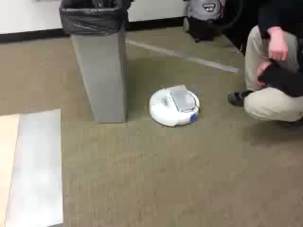

EECS 149: Intro to Embedded Systems at UC Berkeley Lab on The “Hill-Climbing” Robot
Garvit,
Course TA
Goal: Online Virtual Lab with learning experience
“comparable” to On-Campus Real Lab
Notes:
An example of one such course at Berkeley is EECS 149: Introduction to Embedded Systems. In the first 6 weeks, students do the lab assignment that you see depicted in this video, where they program the white robot (programmable version of the Roomba vacuum cleaner) to navigate around obstacles and climb a ramp. Crucially as they design and debug their solutions, they get continuous feedback from excellent TAs. So the question is: how can we create online virtual labs with a comparable learning experience?

Slide 3
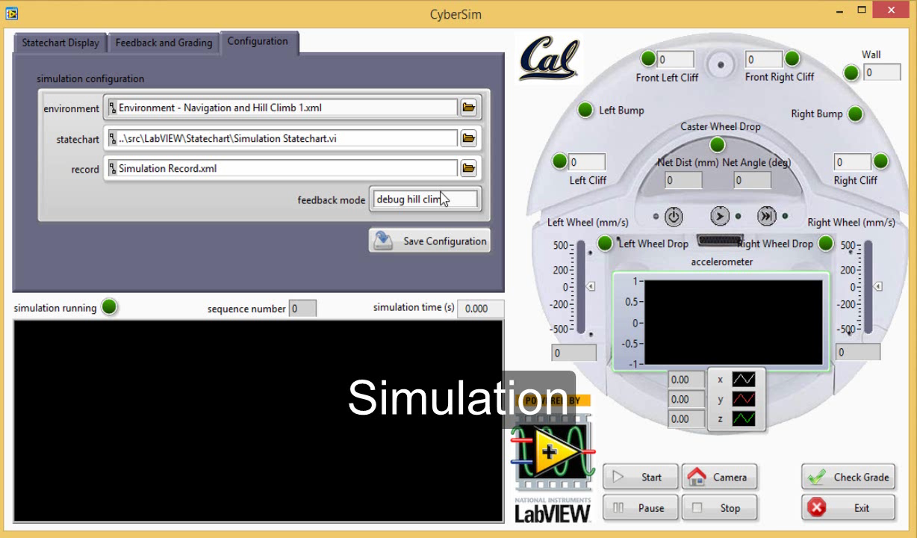
EECS149.1x: Cyber-Physical Systems on edX (May-June 2014) Virtual Lab: CyberSim + CPSGrader
Technology based on Formal Methods
Simulation-based Grading & Feedback Generation
Goals/Faults specified in Signal Temporal Logic
Automatic Synthesis of Temporal Logic Testers [EMSOFT 2014]
Notes:
We’ve worked towards this goal by developing a Virtual Lab Environment, called CyberSim, with an automatic grading back-end, called CPSGrader. As you see in this video, CyberSim shows the student on the RHS a top view of the robot with its sensors and actuators, and on the LHS a visualization of the robot navigating in a virtual environment. This is a complex robotics simulator that includes a detailed model of the physics of the robot and its environment.
The same code than runs in the simulator also runs on the real robot. The automatic grading system not only judges if the solution is right or wrong, but also provides customized feedback. This technology is based on an area of Computer Science known as Formal Methods. Goals or faults for the robot are specified in a mathematical notation called Signal Temporal Logic, and the temporal logic testers are automatically synthesized from examples of good and faulty solutions. This work has been published in EMSOFT 2014, a top research conference in the area of Embedded / Cyber-Physical Systems.

Slide 4
Key Statistics from EECS149.1x
86% found auto-grader feedback useful for debugging
>90% of solutions that passed CPSGrader worked on the real robot with no or minor modifications [optional hardware track]
Majority of students spent 5-10 hours/week
4% of peak enrollment passed the course (342 of 8767)
Future Directions & Collaboration
Enable Virtual Labs in Science and Engineering
Your Simulator + CPSGrader = Virtual Lab for Your Course
Blend Formal Methods with other forms (e.g., peer grading)
User studies
CPSGrader to be released open source in Fall 2014
CPSGrader.org
Notes:
Here are some key statistics from an end-of-course survey. 86% of students deemed the auto-grader feedback useful. We had an optional track for students to purchase the actual hardware, and over 90% of those who did said that if their solution passed CPSGrader it worked for real. Most of the students spent 5-10 hrs/week on lectures and lab, and 4% of the peak enrollment passed the course.
The future has a lot of exciting directions. We believe our auto-grader technology can significantly enhance virtual labs in a range of science and engineering topics. And Formal Methods has a lot to offer Education, and could be blended with other forms of grading. Our software is planned to be released open source later this year. Thanks!

